Slide 1

Koncept- Your Personal Ai Teacher

Slide 2
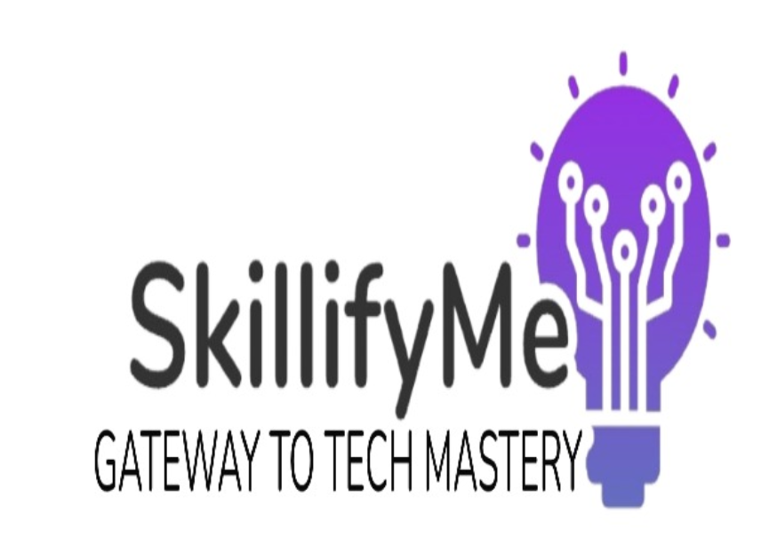
Team ALLIES
HEMANT KUMAR 2823231
VAANI MANGAL 2823212
DEVANSH HURIA 2823225
VIVEK KADYAN 2823230

Slide 3
PROBLEM STATEMENT
Current Limitations of AI Chatbots
Most AI chatbots provide only text-based output
Text is powerful, but it often lacks engagement and interest
Key Problems
Engagement – Plain text feels boring; not interactive or visually appealing
Accessibility – Not suitable for users who face reading difficulties or prefer auditory learning
Usability – Students, teachers, and professionals must spend extra time converting text into slides or audio-visual content
We need an AI chatbot that can automatically generate ready-to-use multimedia presentations — complete with slides and narration.

Slide 4
Literature Review
1) Conversational AI & Chatbots
Limitation: Output is text-only; no built-in audio or video delivery
The focus must shift from text-only to rich media
2) Multimedia Learning Theory
According to Mayer’s Cognitive Theory of Multimedia Learning:
Combining words + pictures + narration improves retention
Dual-channel processing (audio + visual) helps balance cognitive load
This theory supports the idea that chatbot outputs as slideshows + voiceover will enhance learning effectiveness
3) Accessibility & UDL (Universal Design for Learning)
Diverse learners need multiple modes of representation
Summarized studies and approaches related to our topic.
Highlight strengths and limitations
Identify any recurring patterns, common gaps.

Slide 5
Novelty and gap
Gaps
Current chatbots provide text-only responses
No single end-to-end pipeline that converts chatbot output → slides → narration → video
Time-consuming process
Novelty
What Makes Our Work Unique
End-to-end automation: LLM → slides → narration → video
Higher engagement and accessibility: multimedia output
Time-saving: no manual slide/audio creation
Application-ready: usable in classrooms, meetings, seminars
Why This Gap Matters
Classrooms, seminars, and professional meetings demand multimedia content
Plain text alone is no longer sufficient

Slide 6
DATA
No traditional datasets (images, numerical tables, etc.)
Two data sources:
Text data → generated via LLM API
User inputs + AI responses → converted into slides & narration
Data’s role: transform inputs into multimedia output, not for training large models
INPUT
AI TEXT
VIDEO
SLIDES
AUDIO
Data Flow:

Slide 7
METHODOLOGY
User Input Collection – Query given by student/teacher/professional.
Response Generation – LLM creates detailed answer.
Content Structuring – Convert response into slides format (section-wise).
Audio Narration – TTS adds natural voice narration.
Multimedia Integration – Slides + Audio merged into video output.
Final Delivery – Ready-to-use slideshow video presentation.

Slide 8
FEATURES
✅ Successful integration of LLM + PPT generation + TTS
✅ Google Colab environment tested – runs without major dependency errors
✅ Chatbot replies automatically transformed into structured slides
✅ Audio narration (TTS) synced with generated slides
✅ Exported as video – usable directly in classrooms, training, and presentations
✅ Reduced manual effort of slide preparation by >70%
✅Suitable for disables and also who face reading difficulties

Slide 9
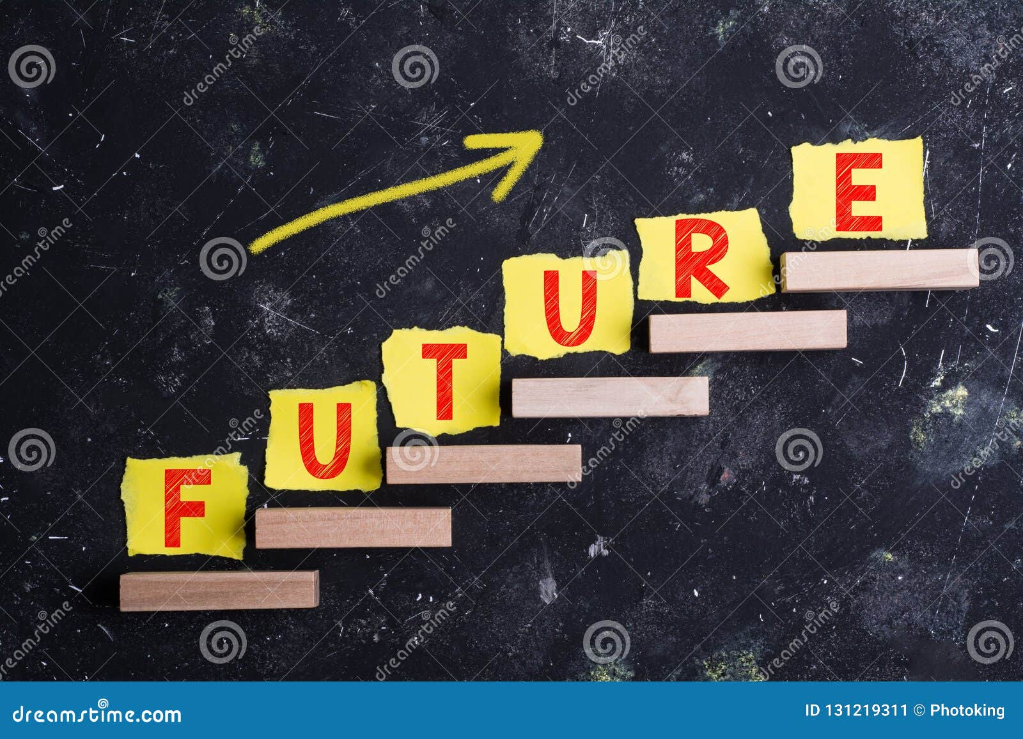
FUTURE PARTS AND APPLICATIONS
Future Parts:
🔹 Multilingual support – AI responses and narration in multiple languages
🔹 Animation Support
🔹 Pictures / Icons Include
🔹 Interactive presentations – quizzes, clickable elements inside generated slides
🔹 Cloud deployment – as a web-based application for global access
Applications:
🎓 Education – AI-powered lecture slides + audio for teachers & students
🏢 Corporate training – quick creation of training modules & seminars
📢 Content creators – YouTubers / educators making instant explainer videos
🤝 Professional meetings – automated presentation drafting from chat discussions
🌍 Accessibility – support for visually impaired or reading-challenged learners

Slide 10
CONCLUSION
✅ Developed an AI chatbot that outputs PPT + audio/video
✅ Addresses key gaps: engagement, accessibility, and usability
✅ Saves time for students, teachers, and professionals
✅ Bridges text-only AI → ready-to-use multimedia
✅ Strong potential for education, corporate training, and assistive tech

Slide 11
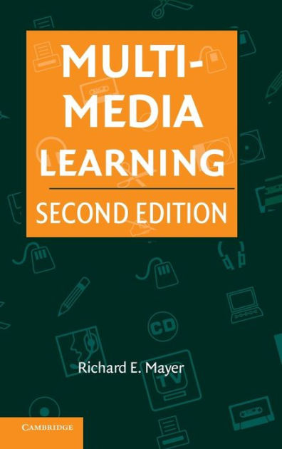


REFERENCES
Mayer, R. E. Multimedia Learning (Cambridge University Press).
Stelzer, T., Gladding, G., Mestre, J., & Brookes, D. T. (2008). Comparing the efficacy of multimedia modules with traditional textbooks for learning.
CAST. (2018). Universal Design for Learning Guidelines (Version 2.2). UDL G
Wood et al., 2018 (PMC)
Refers that tts improves reading comprehension especially for students with reading difficulties.

Slide 12


Thankyou

